Slide 1

Abortion

Slide 2







Summary of Project and Findings
Differences in the content, by newspaper outlets and gender of the authors
~6,500 articles scraped from CNN, Fox News, Federalist, Mother Jones, Vox, TIME, Zeit

Slide 3
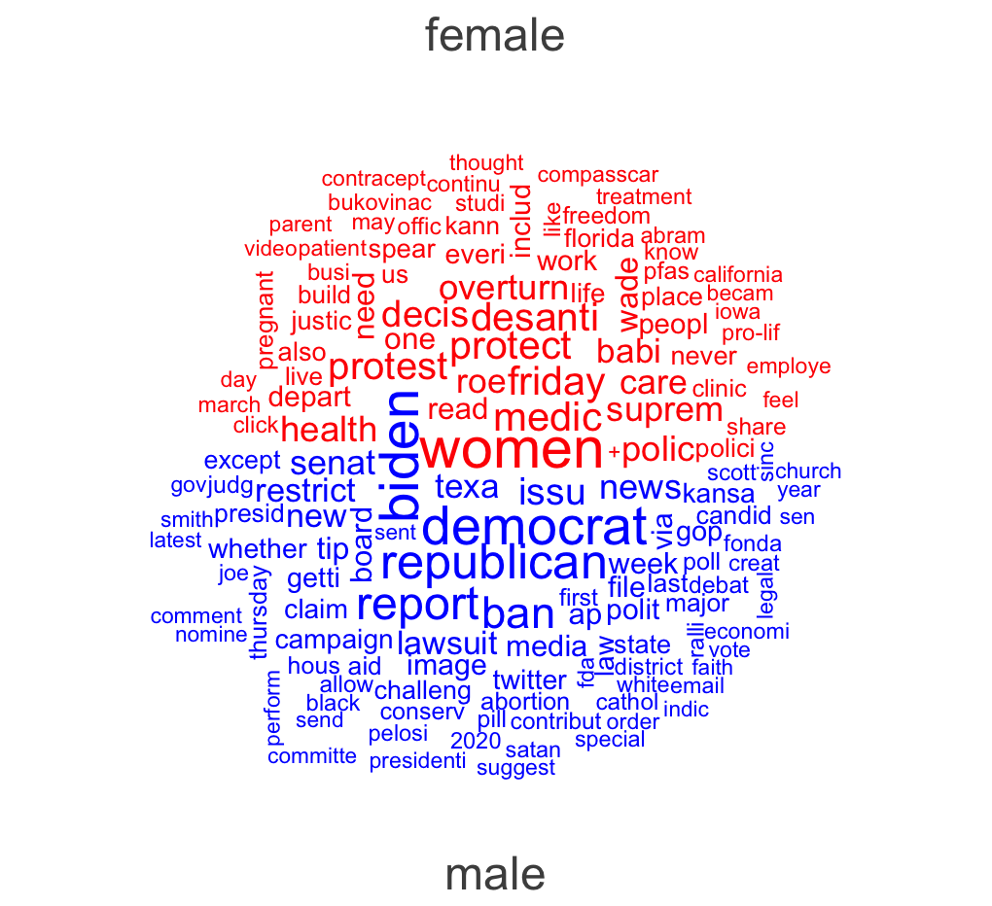
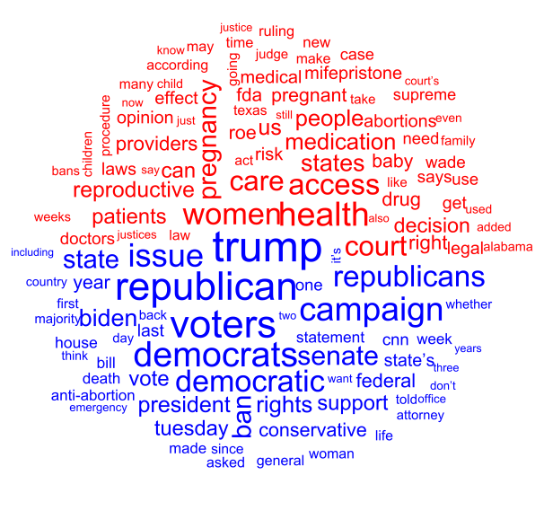
Results Wordclouds

Slide 4
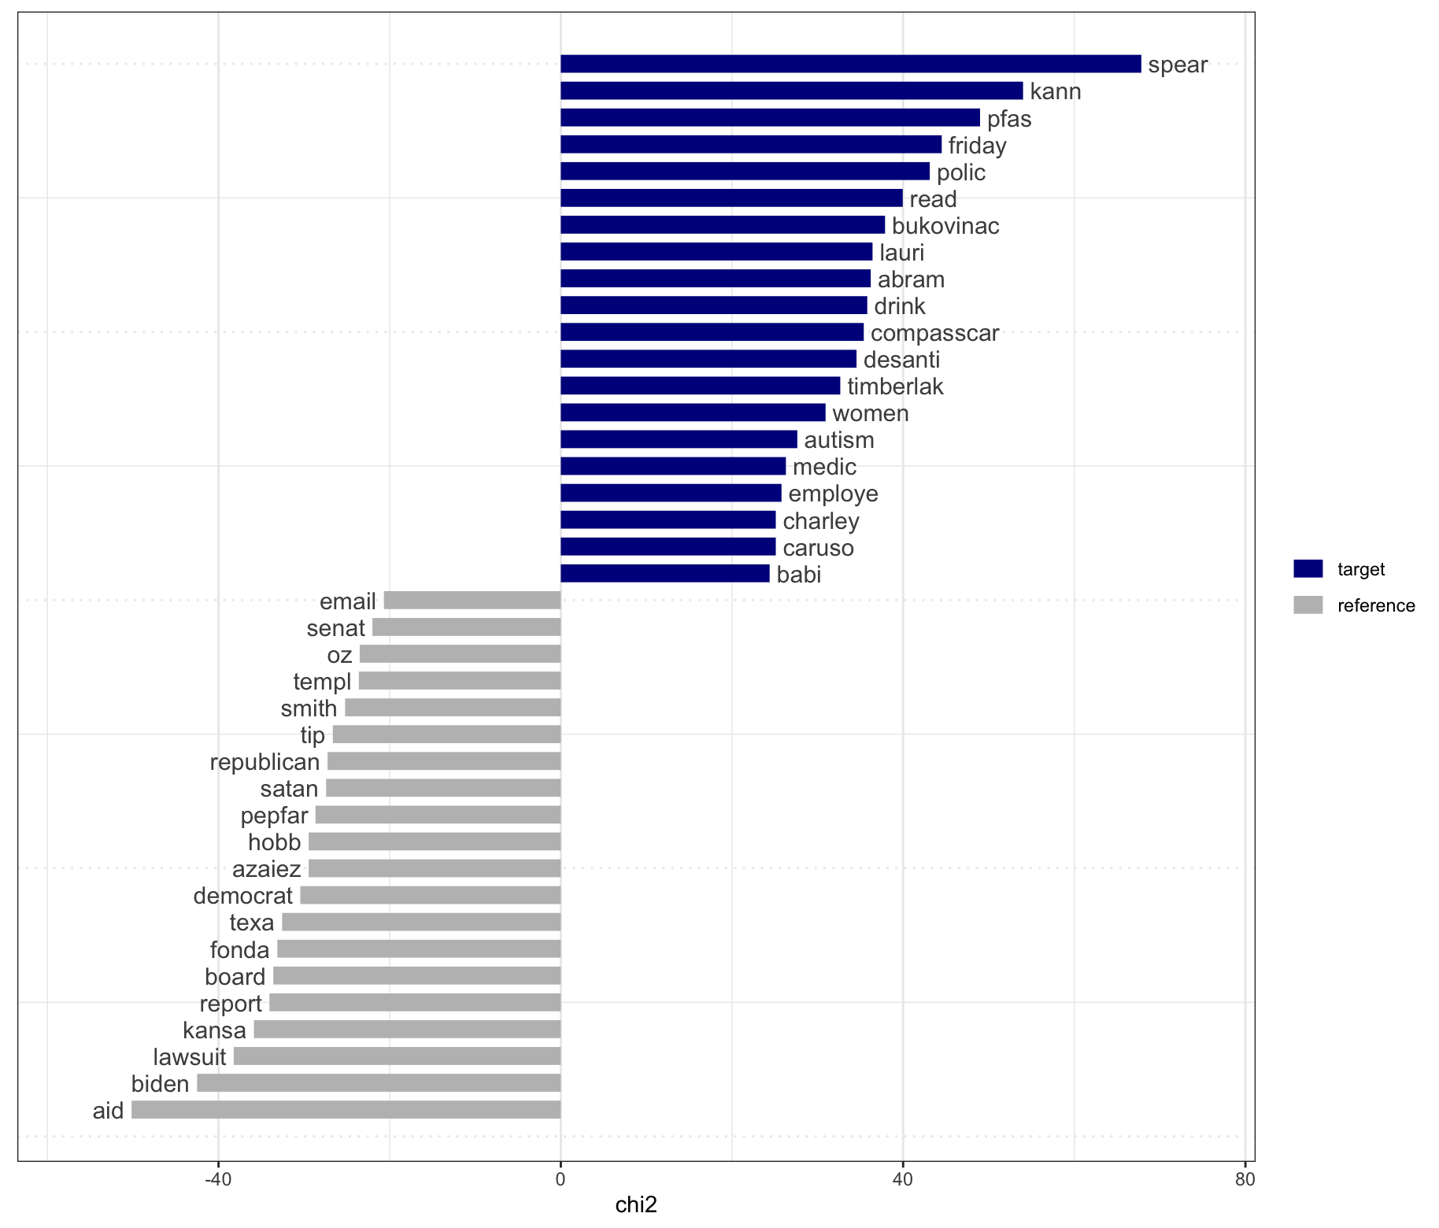
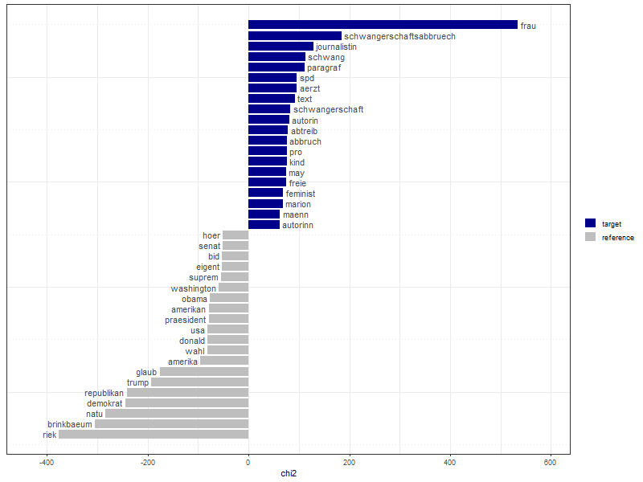
Results Keyness

Slide 5
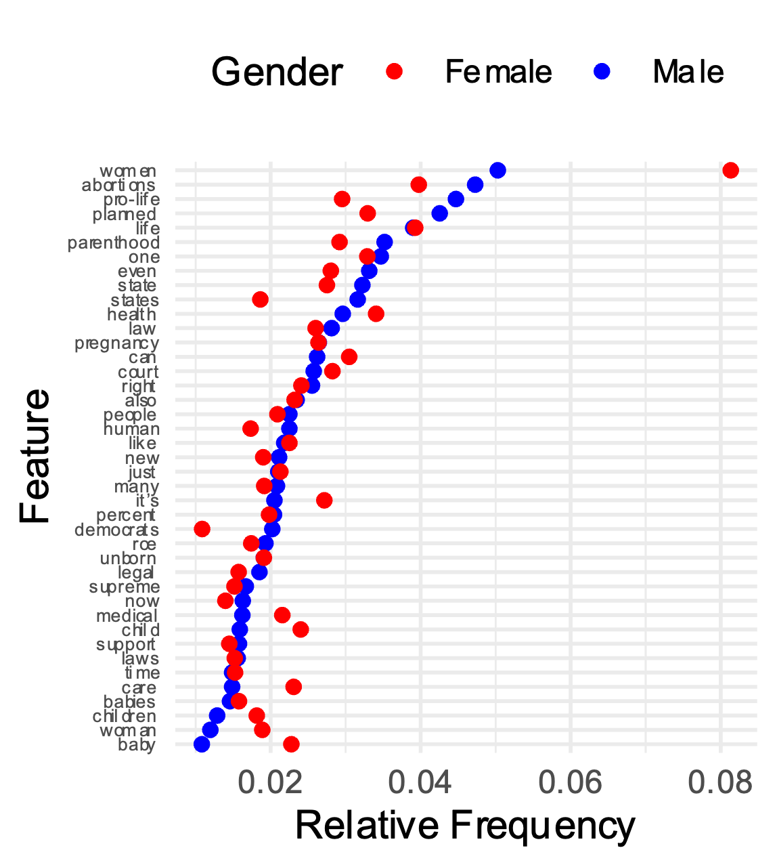
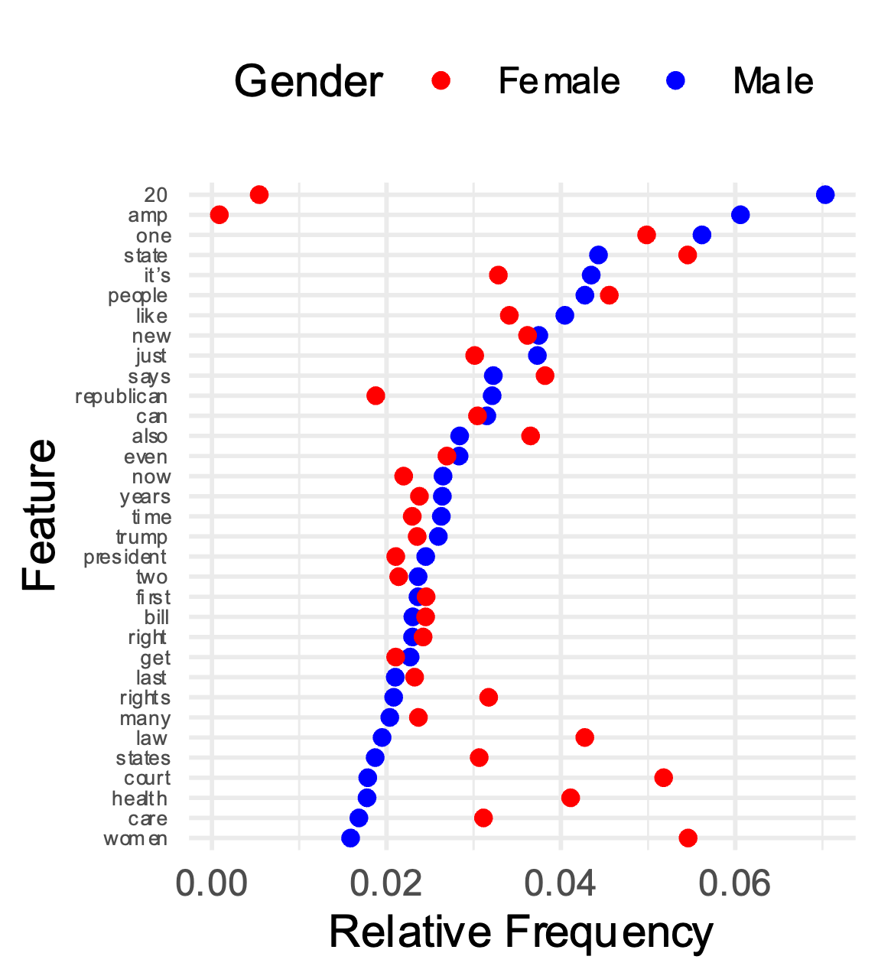
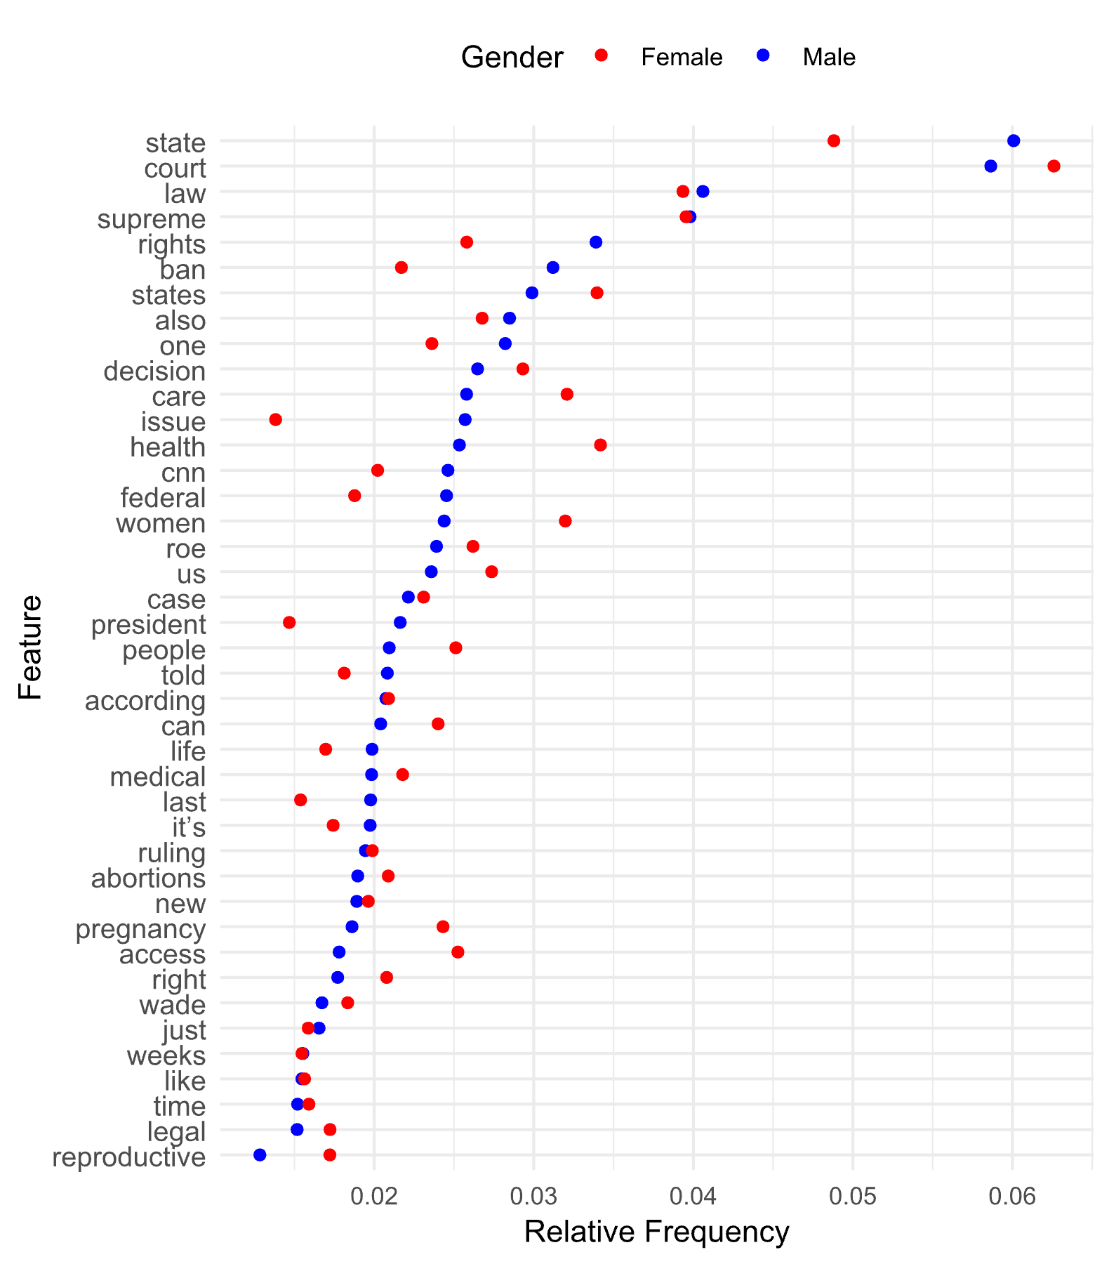
RESULTS GGPLOT

Slide 6
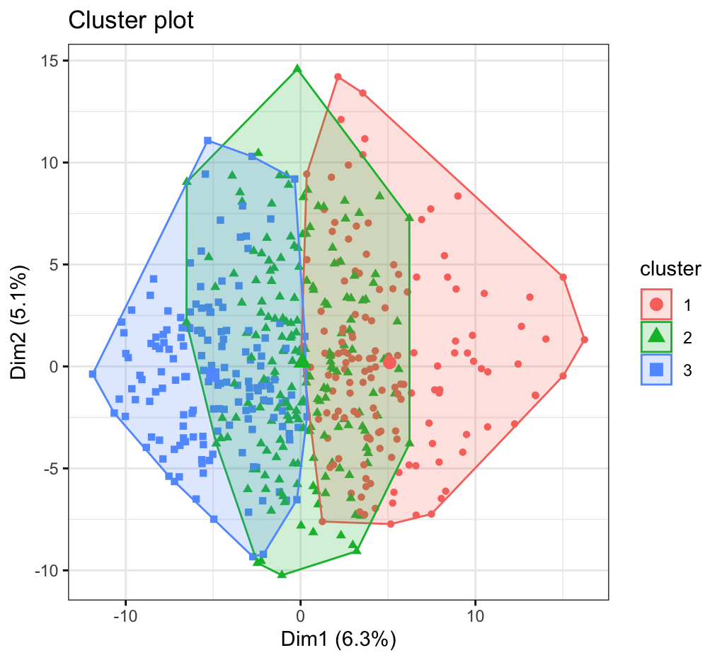
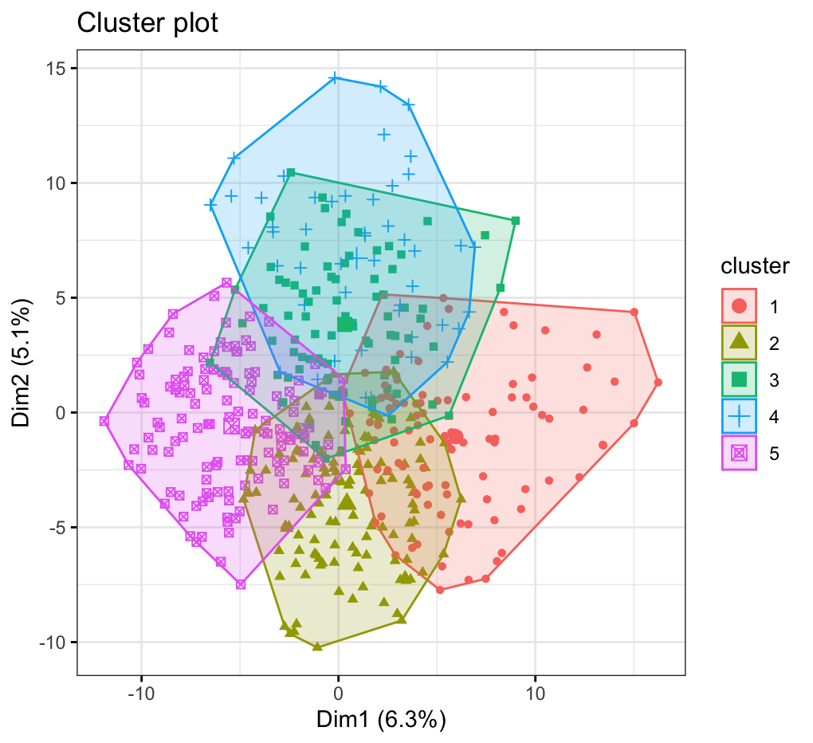
Results Cluster Plot K-Means

Slide 7
Topics LDA
Women’s choice
Health
Law/justice
Politics?
Women’s rights?
Law/justice
1 | women | planned | court
2 | life | women | state
3 | one | parenthood | law
4 | pro-life | health | states
5 | people | medical | pro-life
6 | child | care | roe
7 | like | pregnancy | democrats
8 | even | percent | supreme
9 | human | clinics | right
10 | baby | clinic | bill
1 | news | women | state
2 | roe | clinic | court
3 | fox | peopl | news
4 | biden | march | fox
5 | state | work | pill
6 | democrat | life | drug
7 | trump | like | mifepriston
8 | ban | worker | restrict
9 | wade | just | new
10 | presid | it‚Äô | fda

Slide 8
Problems you encountered
Web scraping
Scraping websites that use lots of JavaScript (e.g. Fox News, VOX)
Selecting blocks without unique identifiers
Had to collect URLs in batches since the “next” button wouldn’t work after p. 5
Pre-processing
Assigning gender to authors with less common names
German language: Many more stopwords in the German language, Umlaut (i.e., ä, ü)
Making sense of features and adjusting stopwords
Results
Lots of time spent on plot output and saving
Ambiguous results (e.g. valence analysis)

Slide 9
Learnings for next time
Collaborate in one code document?
Unify datasets early on
Make plot output process more efficient
Not all analyses make sense

Slide 10
THANK YOU!

Slide 11
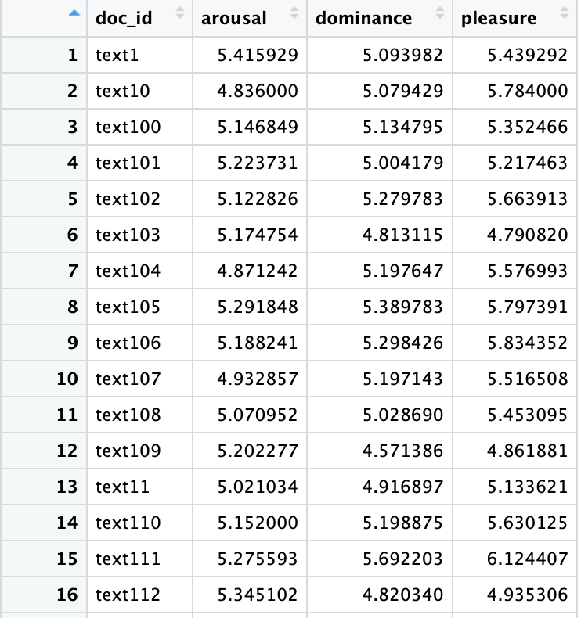
Valence FOX NEWS

